Slide 1
WHY
Business Challenges
Use Case Description
KPIs Impacted
Renewable volatility & DER unpredictability
Operator overload & manual processes
Slow contingency analysis & lack of automation
High congestion, overloads & voltage issues
Strict safety, compliance & audit requirements
Sudden wind drops cause rapid feeder loading → overload risk Voltage and VAR fluctuations triggered by renewable variability SCADA alarms alert only after thresholds are crossed → delayed response Manual decision‑making slows contingency resolution Asset thermal stress increases fault probability DER curtailment reduces renewable utilization KPIs
Real-time resilience Approach
Microsoft AI Foundry to automatically detect grid risks such as sudden wind generation drops and rising feeder loads. Real‑time SCADA, PMU, weather, and DER telemetry are fused by AI agents that simulate contingencies and instantly recommend safe switching, reconfiguration, and voltage/VAR actions. Instead of operators manually analyzing multiple systems, the AI provides a clear, confidence‑scored action plan improving response time, preventing overloads, and ensuring safe, compliant grid operations.
Business Impact
Increased outages lead to regulatory penalties Overloaded feeders and stressed assets create high maintenance cost Voltage violations harm compliance and audit scores Slower operator actions increase risk of service disruption DER curtailment reduces renewable revenue Poor reliability degrades customer satisfaction and brand trust
Control Room Team,
Engineering & Planning,
Field Operations,
DER Ecosystem,
IT & Digital,
Regulatory & Business,
Consumers & Partners
HOW
WHO
Functional Solution
Technical Solution
Stakeholders
Telemetry ingestion (SCADA/EMS/PMU/DER)
Weather + forecast integration
Contingency simulation & predictive overload analysis
Voltage/VAR analysis & switching recommendation
Operator advisory with confidence scoring
AI Foundry datasets + governed RAG knowledge base
Python load-flow & rule-based simulation tools
LLM + Tools hybrid reasoning for accuracy
Agent orchestration & telemetry triggers
Monitoring, guardrails & safety validation
Data Collection Agent
Contingency Simulation Agent
Operator Advisor Agent
Governed RAG for SOPs, topology & safety rules

Slide 2
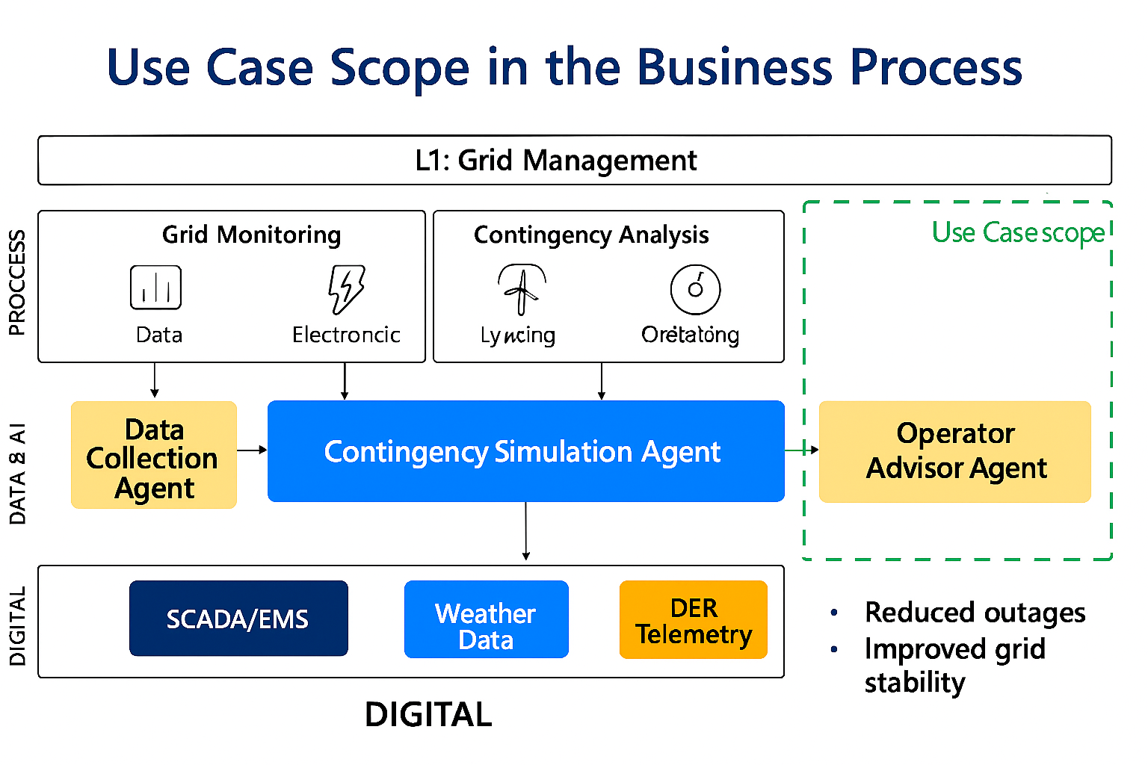
Use Case Scope in the Business Process
L1 Process: Grid Management L2 Activities: Grid Monitoring → Contingency Analysis Use Case Scope Highlighted Digital Systems Layer: SCADA/EMS, Weather Data, DER Telemetry Data & AI Layer: Data Collection → Contingency Simulation → Operator Advisor

Slide 3
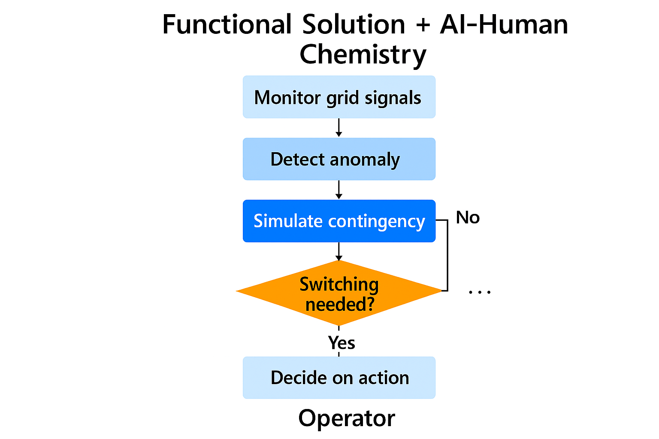
Functional Solution + AI-Human Chemistry

Slide 4
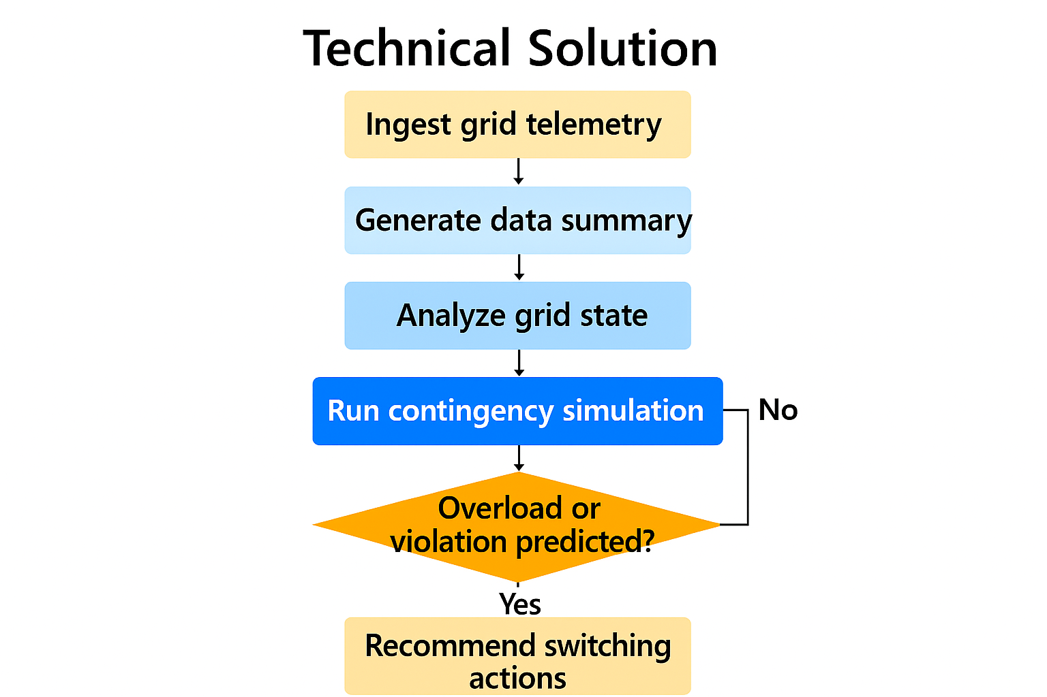
Technical Solution
technologies

Slide 5
Business Case Proposal
Business Impact
20–40% faster contingency response
15–25% reduction in outage apprcv
Productivity gain scoring
Current Costs / Pain Points
20–40% faster contingency response time
15–25% reduction in outage duration (SAIDI/SAIFI)
30–50% reduction in manual operator effort
Higher renewable hosting capacity (+10–20%)
Financial Model
Current inefficiencies • 12–18 months
Avoided outages

